Slide 1
Machine Learning Introduction
Lecture-1

Slide 2
Introduction
Machine Learning (ML) is considered as the most dynamic and progressive form of human-like Artificial Intelligence.
Today ML is being used extensively in various industries like automobiles, genetics, medicine, finance etc. to automate procedures, in reducing the processing time and to remove the possibility of human errors.
ML helps in analyzing at a large scale, thus helping in making quicker and better decisions.

Slide 3
Artificial Intelligence (AI) & Machine Learning (ML)?
Artificial intelligence:
Artificial intelligence is the name given to the process in which the computer makes decisions, mimicking a human.
Computing
AI
ML
DL
Machine learning:
Computer makes decisions based on experience.

Slide 4
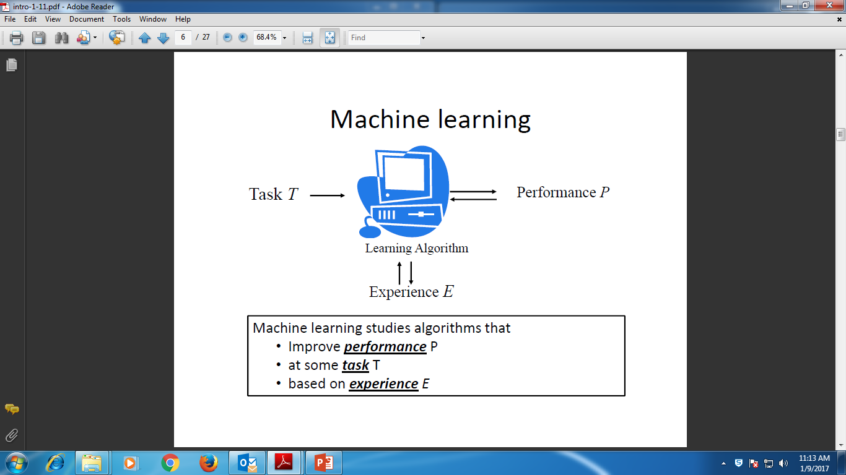
Programming and Machine Learning
Programming Solution
Machine Learning solution
Input Program
Data Output
Computer
Algorithm - Machine
Output
Learn through experience

Slide 5

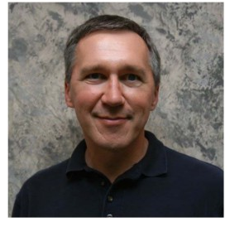
Machine Learning - Definition
1997, Tom Mitchell gave a definition:
Machine Learning Scientist,
Carnegie Mellon University
A computer program is said to learn from experience E with respect to some class of tasks T and performance measure P, if its performance at tasks in T, as measured by P, improves with experience E.

Slide 6
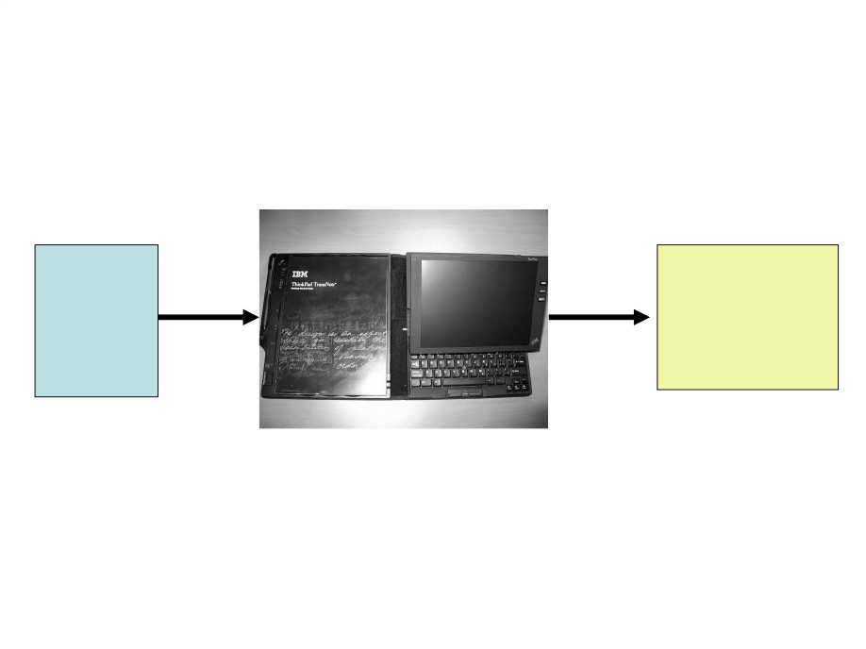
What Machine Learning does???
Training
Decision Function
Examples
/ Hypothesis
New Query?

Slide 7
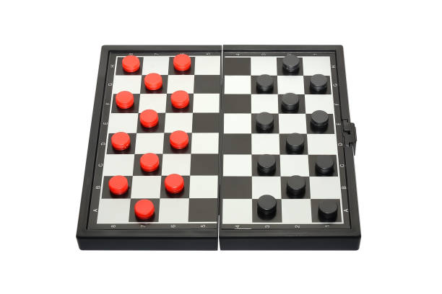
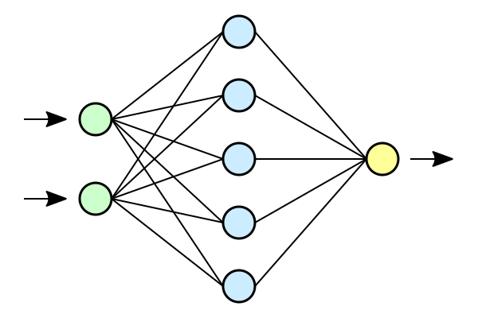
Introduction – History
1950s
  Arthur Samuel (IBM)
  Program – playing Checkers game
1960s
  Rosenblatt
  Perceptron - Neural Network Model
  Pattern Recognition
  Later delta learning rule
    Rule for perceptron learning
    Good classifier

Slide 8
Introduction – History
1950s
  Arthur Samuel (IBM)
  Program – playing Checkers game
1960s
  Rosenblatt
  Perceptron - Neural Network Model
  Pattern Recognition
  Later delta learning rule
    Rule for perceptron learning
    Good classifier
1969
  Minsky and Papert
  Limitation of perceptron model
  Problem could not be represented
  Inseparable data distribution
1970s
  Symbolic concept (AI)
1986
  Quinlan – Decision Tree
  ID3 Algorithm
  Improved: Regression
  Still popular in ML

Slide 9
Introduction – History
1990s: Machine learning involved statistics to a large extent
1994 – Self driving car road test
In 1995 –Support Vector Machines (SVMs)
In 1997, ensembles or boosting - algorithm for classification
1997 – Deep Blue beats Garry Kasparov
2009 – Google builds self driving car
2011 – Watson wins Jeopardy
2015 - machine translation systems driven by NN - better than statistical machine translation systems

Slide 10
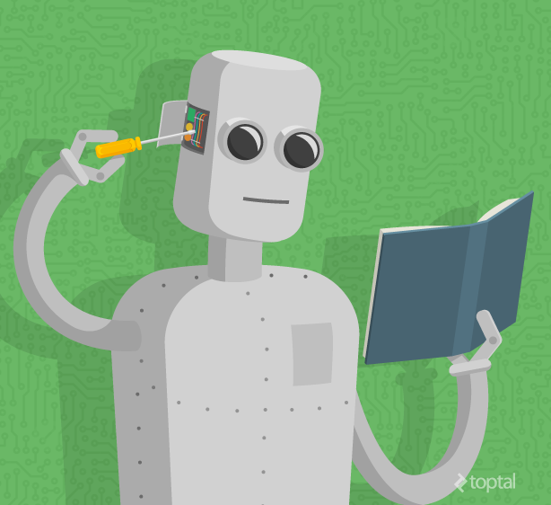
Current status
Today,
  Algorithms – developed for learning tasks
  Theoretical understanding - emerged
  Practical computer programs -developed
  Commercial applications - appear.

Slide 11
Data and Features
What is data?
Data is simply a table with information
Each row is a data point
Each row represented by certain features
What are features?
Features are simply the columns of the table.
Features may be size, name, type, weight, etc.
Some features are special, and we call them labels.
NO. | SIZE | COLOR | SHAPE | FRUIT NAME
1 | Big | Red | Rounded shape with a depression at the top | Apple
2 | Small | Red | Heart-shaped to nearly globular | Cherry
3 | Big | Green | Long curving cylinder | Banana
4 | Small | Green | Round to oval, Bunch shape Cylindrical | Grape

Slide 12
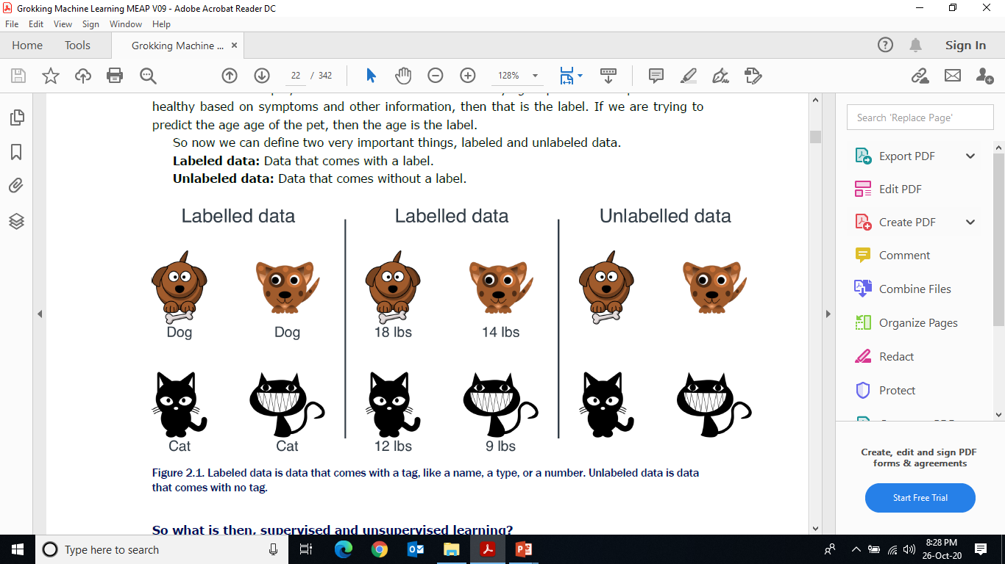
What is the difference between labelled and unlabelled data?
Labels?
If we are trying to predict a feature based on the others, that feature is the label.
Labeled data: Data that comes with a label.
Unlabeled data: Data that comes without a label
The set of algorithms in which we use a labeled dataset is called supervised learning.
The set of algorithms in which we use an unlabeled dataset, is called unsupervised learning.

Slide 13
Types of Machine Learning
Supervised Learning
Unsupervised Learning
Reinforcement Learning
Deep Learning

Slide 14
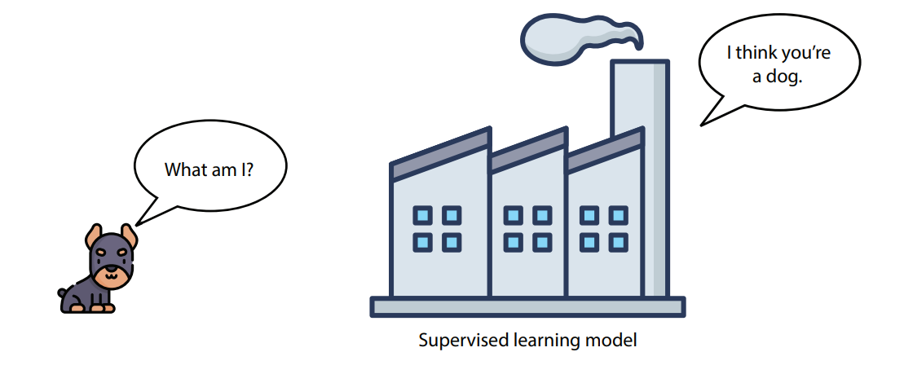
Supervised Learning
A branch of machine learning that works with labeled data.
Some of the most common applications:
  image recognition
  various forms of text processing
  recommendation systems.
Goal of a supervised learning model: predict the labels.

Slide 15
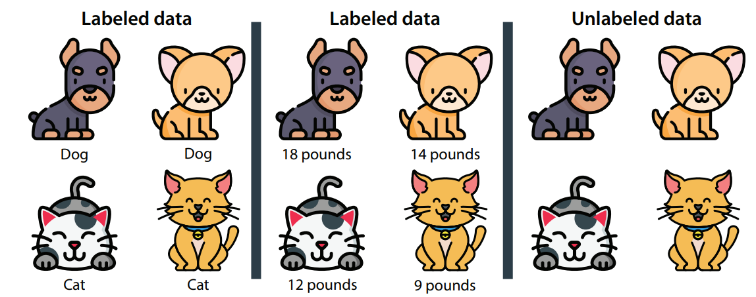
Types of labeled datasets
Numbers and states are the two types of data used in supervised learning models.
In this dataset, the labels are numbers.
We call this type - numerical data
numerical data - is any type of data that uses numbers such as 4, 2.35, or –199.
Example: prices, sizes, or weights.
In this example, each data point in the dataset is labeled with the weight of the animal.

Slide 16
Types of labeled datasets
In this dataset, the labels are states.
We call this type - categorical data.
categorical data - is any type of data that uses categories, or states, such as male/female or cat/dog/bird.
For this type of data, we have a finite set of categories to associate to each of the data points.
each data point in the dataset is labeled with the type of animal (dog or cat)

Slide 17
Types of supervised learning models
regression models are the types of models that predict numerical data.
The output of a regression model is a number, such as the weight of the animal.
classification models are the types of models that predict categorical data.
The output of a classification model is a category, or a state, such as the type of animal (cat or dog).

Slide 18
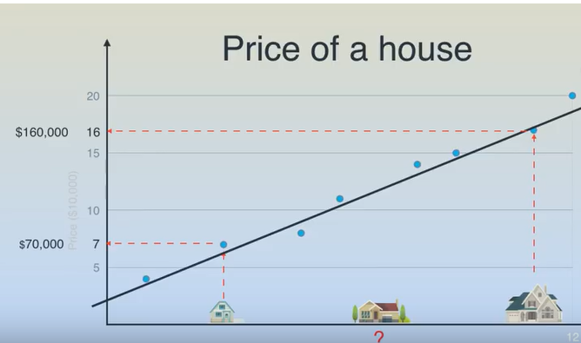
Example of regression model
Model 1: housing prices model.
Each data point is a house.
The label of each house is its price.
Goal: when a new house (data point) comes on the market, we would like to predict its label (price).

Slide 19
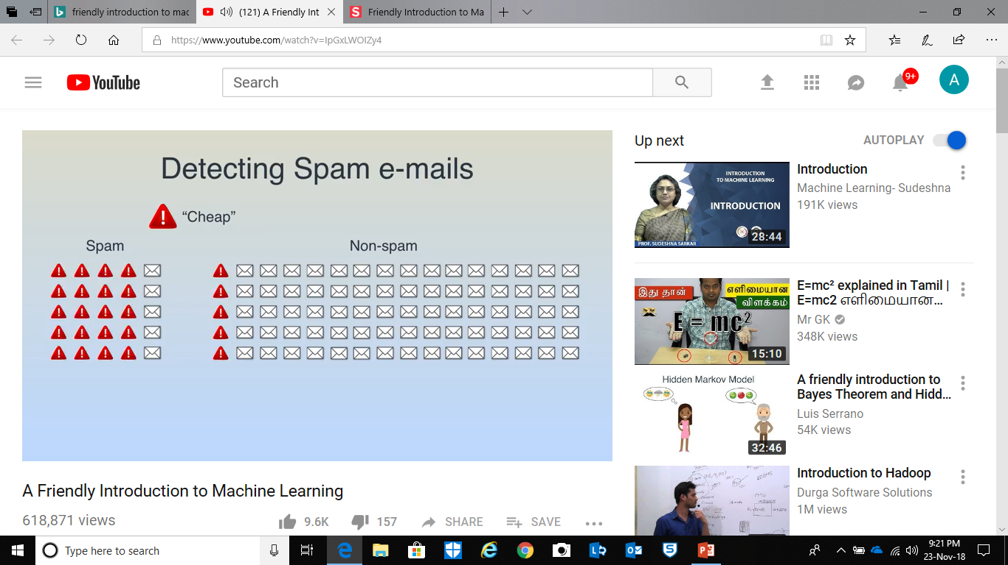
Example of classification model
Model 2: email spam–detection model.
Each data point is an email.
The label of each email is either spam or ham.
Goal: when a new email (data point) comes into our inbox, we would like to predict its label (whether it is spam or ham).

Slide 20
Examples of supervised learning models
Difference between models 1 and 2.
Housing prices model, can return a number from many possibilities, such as $100, $250,000, or $3,125,672.33.
Thus, it is a regression model.
The spam detection model, can return only two things: spam or ham. Thus, it is a classification model.

Slide 21
Regression models
Predict numbers based on the features
In the housing example, the features can be anything that describes a house, such as the size, the number of rooms, the distance to the closest school, or the crime rate in the neighborhood.
House size | No. of rooms | Distance to school | Crime rate in the neighborhood | Price
IDV | IDV | IDV | IDV | DV

Slide 22
Other applications of regression model:
Stock market: predicting the price of a certain stock based on other stock prices and other market signals
Medicine: predicting the expected life span of a patient or the expected recovery time, based on symptoms and the medical history of the patient
Sales: predicting the expected amount of money a customer will spend, based on the client’s demographics and past purchase behavior
Video recommendations: predicting the expected amount of time a user will watch a video, based on the user’s demographics and other videos they have watched

Slide 23
Linear regression
The most common method used for regression is linear regression, which uses linear functions (lines or similar objects) to make our predictions based on the features.

Slide 24
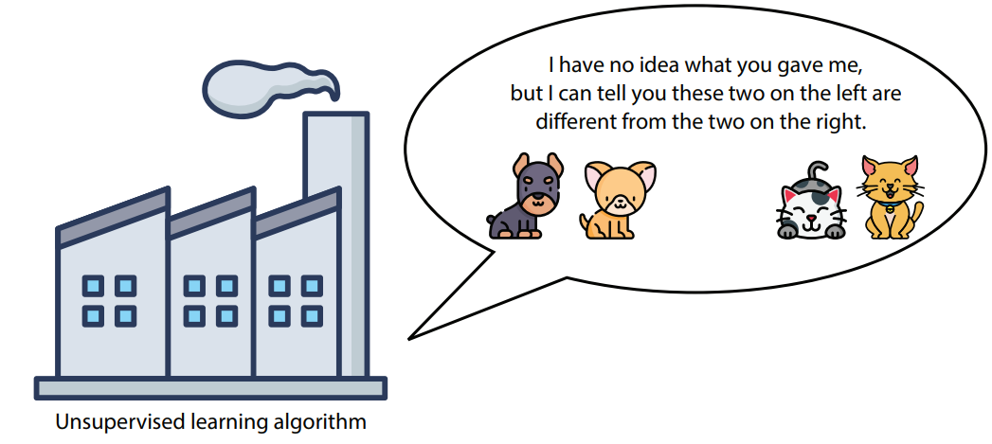
Unsupervised learning
Machine learning algorithms that works with unlabeled data.
MLA must extract as much information as possible from a dataset (has no labels, or targets) to predict.
Determine - two pictures are similar or different

Slide 25
Unsupervised learning
Even if the labels are there, we can still use unsupervised learning techniques on our data to preprocess it and apply supervised learning methods more effectively.
clustering algorithms The algorithms that group data into clusters based on similarity.
dimensionality reduction algorithms The algorithms that simplify our data and describe it with fewer features
generative algorithms The algorithms that can generate new data points that resemble the existing data

Slide 26
Clustering is an unsupervised machine learning - group the elements in our dataset into clusters where all the data points are similar.
Clustering
Consider the two datasets used in “Supervised learning”—the housing dataset and the email dataset.
Imagine that they have no labels
  House price prediction – price is not available
  Email classification – spam or ham is not available.
housing dataset - What can we do with this dataset?
  Here is an idea: we could somehow group the houses by similarity.
  For example, we could group them by location, size, or a combination of these factors.
  This process is called clustering.

Slide 27
Clustering
Example – email dataset
  The dataset is unlabeled, we don’t know whether each email is spam or ham.
  We can apply some clustering to this dataset.
  Group the emails – based on the number of words in the message, the sender, the number and size of the attachments, or the types of links inside the email.
  After clustering the dataset, a human (or a combination of a human and a supervised learning algorithm) could label these clusters by categories such as “Personal,” “Social,” and “Promotions.”

Slide 28
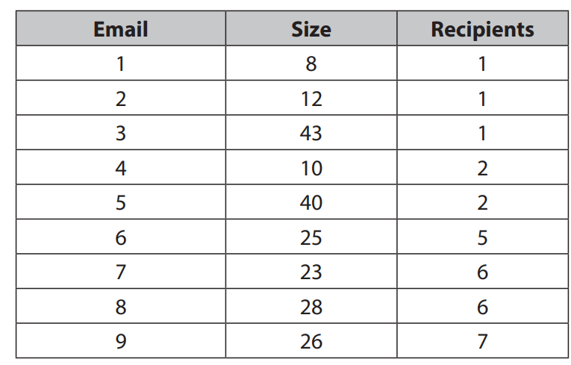
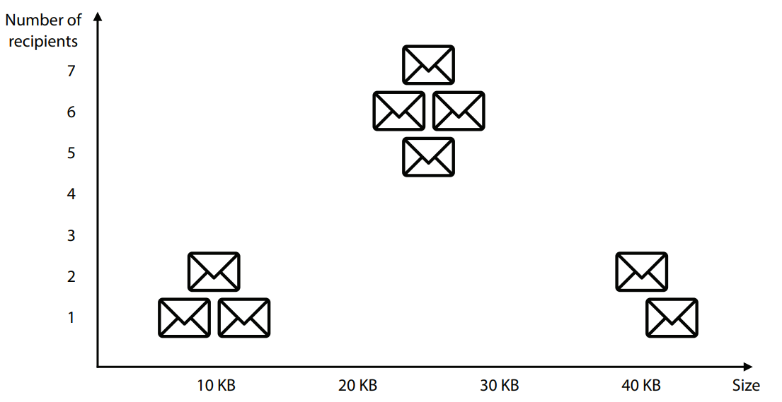
cluster the emails into three categories based on size and number of recipients
Social
Promotions
Personal

Slide 29
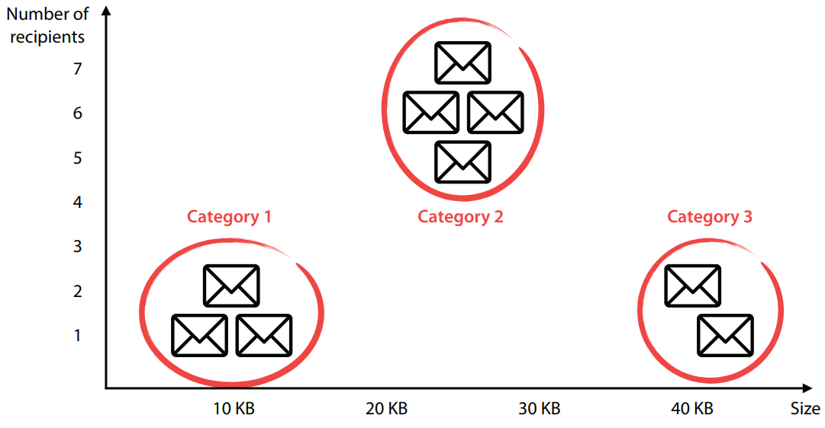

Slide 30
Other applications of clustering
Market segmentation: dividing customers into groups based on demographics and previous purchasing behavior to create different marketing strategies for the groups
Genetics: clustering species into groups based on gene similarity
Medical imaging: splitting an image into different parts to study different types of tissue
Video recommendations: dividing users into groups based on demographics and previous videos watched and using this to recommend to a user the videos that other users in their group have watched

Slide 31
Popular clustering algorithms
K-means clustering: this algorithm groups points by picking some random centers of mass and moving them closer and closer to the points until they are at the right spots.
Hierarchical clustering: this algorithm starts by grouping the closest points together and continuing in this fashion, until we have some well-defined groups.
Density-based spatial clustering (DBSCAN): this algorithm starts grouping points together in places with high density, while labeling the isolated points as noise.
Gaussian mixture models: this algorithm does not assign a point to one cluster but instead assigns fractions of the point to each of the existing clusters.
For example, if there are three clusters, A, B, and C, then the algorithm could determine that 60% of a particular point belongs to group A, 25% to group B, and 15% to group C.

Slide 32
Dimensionality reduction
Simplifies data without losing too much information
Example: housing dataset
Imagine the features are the following:
  C1: Size
  C2: Number of bedrooms
  C3: Number of bathrooms
  C4: Crime rate in the neighborhood
  C5: Distance to the closest school
  This dataset has five columns of data.
  What if we wanted to turn the dataset into a simpler one with fewer columns, without losing a lot of information?

Slide 33
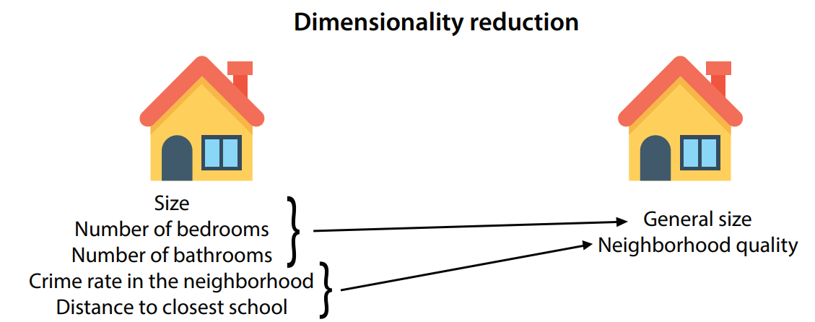
Dimensionality reduction
first three features are similar, because they are all related to the size of the house.
fourth and fifth features are similar to each other, because they are related to the quality of the neighborhood.

Slide 34
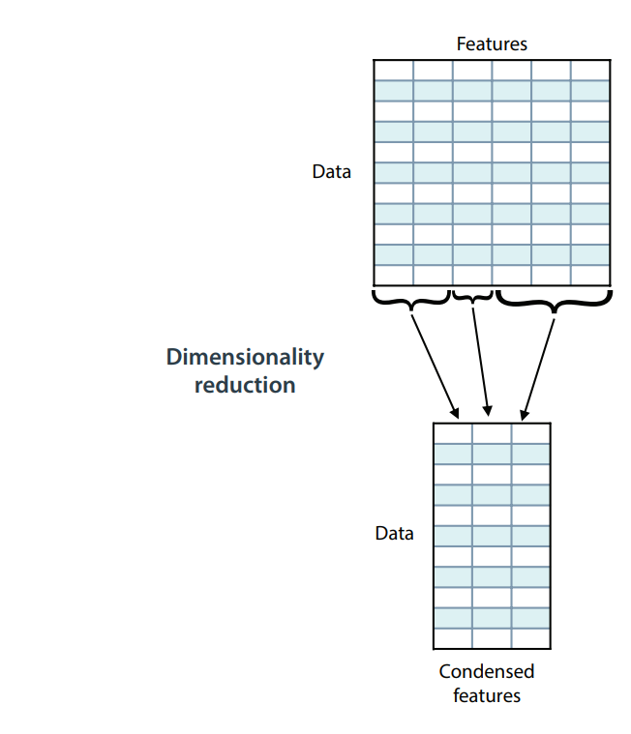
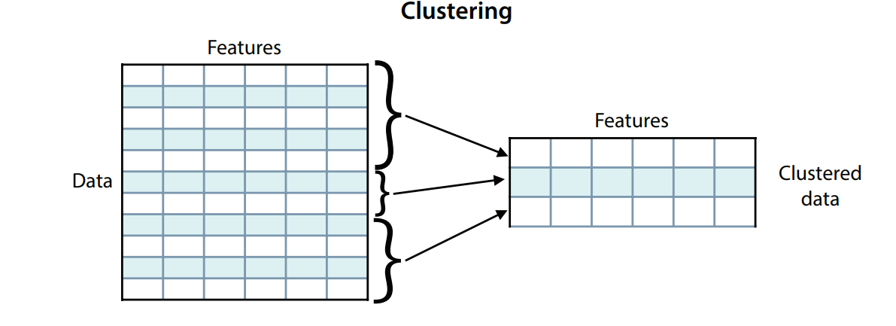
Clustering & dimensionality reduction
If we have a table full of data, each row corresponds to a data point, and each column corresponds to a feature.
we can use clustering to reduce the number of rows in our dataset and dimensionality reduction to reduce the number of columns

Slide 35
Other ways of simplifying our data: Matrix factorization and singular value decomposition
How can we reduce both the rows and the columns at the same time?
  matrix factorization and singular value decomposition (SVD).
  These two algorithms express a big matrix of data into a product of smaller matrices
  Netflix use matrix factorization extensively to generate recommendations.
    a large table where each row corresponds to a user, each column to a movie, and each entry in the matrix is the rating that the user gave the movie.
    With matrix factorization, one can extract certain features, such as type of movie, actors appearing in the movie, and others, and be able to predict the rating that a user gives a movie, based on these features.

Slide 36
Two common types of unsupervised learning algorithms are clustering and dimensionality reduction.
  Clustering is used to group data into similar clusters to extract information or make it easier to handle.
  Dimensionality reduction is a way to simplify our data, by joining certain similar features and losing as little information as possible.
  Matrix factorization and singular value decomposition are other algorithms that can simplify our data by reducing both the number of rows and columns.

Slide 37
Generative machine learning is an innovative type of unsupervised learning, consisting of generating data that is similar to our dataset.
  Generative models can paint realistic faces, compose music, and write poetry.

Slide 38
Applications of Machine Learning
Speech and Hand Writing Recognition
•
• Robotics (Robot locomotion)
• Search Engines (Information Retrieval)
• Learning to Classify new astronomical structures
• Medical Diagnosis
• Learning to drive an autonomous vehicle
• Computational Biology/Bioinformatics
• Computer Vision (Object Detection algorithms)
• Detecting credit card fraud
ML solves problems that cannot be solved by numerical means alone
• Stock Market analysis
• Game playing
•
………………..
•
………………….

Slide 39
Reinforcement Learning
  Reward based learning
Wake-up
had bath
Reinforcement Learning
  Rewards (+ve or –ve)
  Wake-up, brushed teeth, had bath, had breakfast, reach college
10
1
brush teeth
had breakfast
Attend offline class
15
8

Slide 40
Types of Machine Learning
Supervised Learning
Unsupervised Learning
Reinforcement Learning
Deep Learning

Slide 41
Deep Learning
In the past few years, Deep Learning has generated much excitement in Machine Learning
  Many breakthrough results in speech recognition, computer vision and text processing.

Slide 42
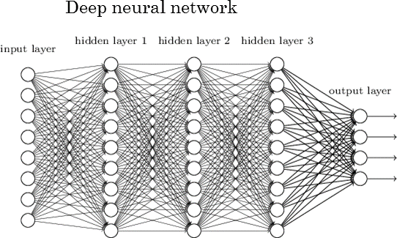
Deep Learning
“very large neural networks and huge amounts of data that we have access to”

Slide 43
Low level representation

Slide 44
Thank you

